Slide 1

DIRECT INDIRECT SPEECH

Slide 2

What is Direct and Indirect Speech?

Slide 3

Direct Speech
When we want to describe what someone said, one option is to use direct speech.
It allows writers to authentically capture the voices and personalities of their characters,
making dialogue more engaging and impactful. We use direct speech when we simply
repeat what someone says, putting the phrase between speech marks:
Paul came in and said, “I’m really hungry.”
It is very common to see direct speech used in books or in a newspaper article. For example:
The local MP said, “We plan to make this city a safer place for everyone.”

Slide 4
As you can see, with direct speech it is common to use the verb ‘to say’ (‘said’ in the past).
But you can also find other verbs used to indicate direct speech such as ‘ask’, ‘reply’, and ‘shout’.
For example:
When Mrs. Diaz opened the door, I asked, “Have you seen Lee?”
She replied, “No, I haven’t seen him since lunchtime.”
The boss was angry and shouted, “Why isn’t he here? He hasn’t finished that report yet!”

Slide 5


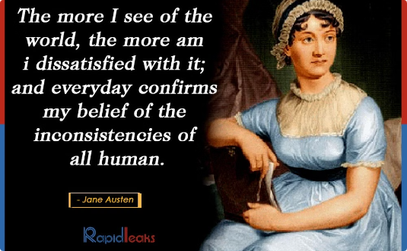
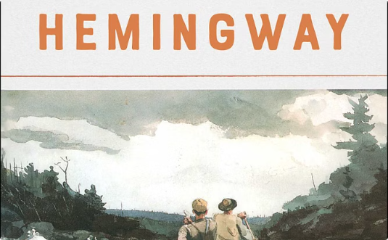
Examples of Direct Speech in Writing
Charles Dickens
Jane Austen
Ernest Hemingway
"It was the best of times, it was the worst of times."
"I declare after all there is no enjoyment like reading!"
"The sun also rises, and the sun goes down, and hastens the place where it arose."

Slide 6

Indirect Speech
When we want to report what someone said without speech marks and without necessarily using exactly the same words, we can use indirect speech (also called reported speech).
For example:
Direct speech: “We’re quite cold in here.”
Indirect speech: They say (that) they’re cold.

Slide 7

When we report what someone says in the present simple, as in the previous sentence, we normally don’t change the tense, we simply change the subject.
However, when we report things in the past, we usually change the tense by moving it one step back. For example, in the following sentence the present simple becomes the past simple in indirect speech:
Direct speech: “I have a new car.”
Indirect speech: He said he had a new car.

Slide 8
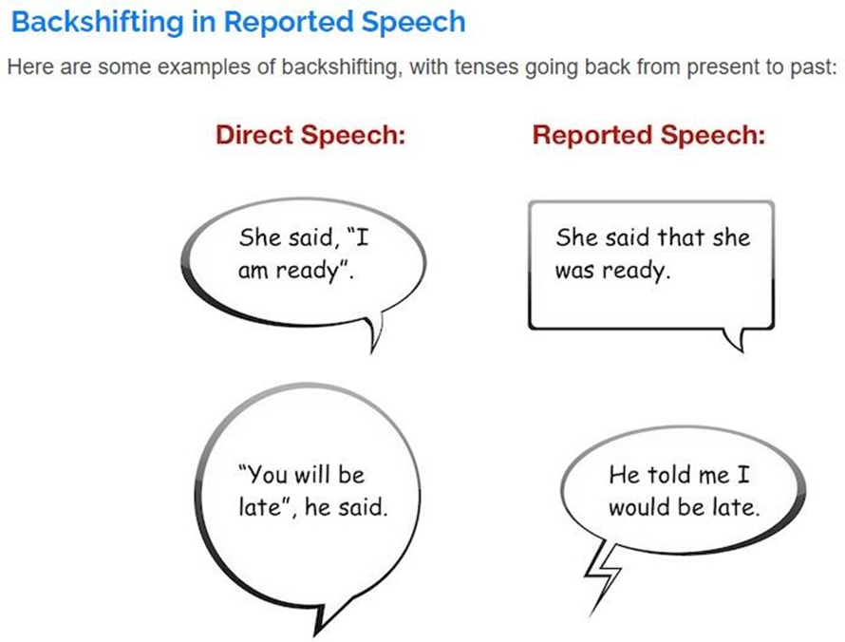

Slide 9
Direct and Indirect Speech Rules
Rule #1 - Direct to Indirect Speech Conversion - Reporting Verb
1. When the reporting verb of direct speech is in past tense then all the present tenses are changed to corresponding past tense in indirect speech.
Example:
Direct: She said, “I am happy.”
Indirect: She said (that) she was happy.
2. In indirect speech tenses do not change if the words used within the quotes (“ ”) talk of a habitual action or universal truth.
Example:
Direct: He said, “we cannot live without air.”
Indirect: He said that we cannot live without air.

Slide 10

3. The tenses of direct speech do not change if the reporting verb is in future tense or present tense.
Example:
Direct: She says/will say, “she is going.”
Indirect: She says/will say she is going.

Slide 11
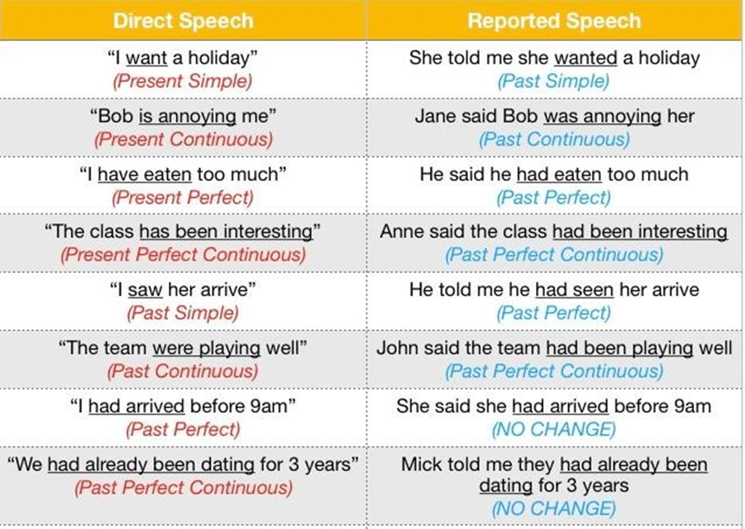
Rule #2 - Direct Speech to Indirect Speech conversion - Tense

Slide 12
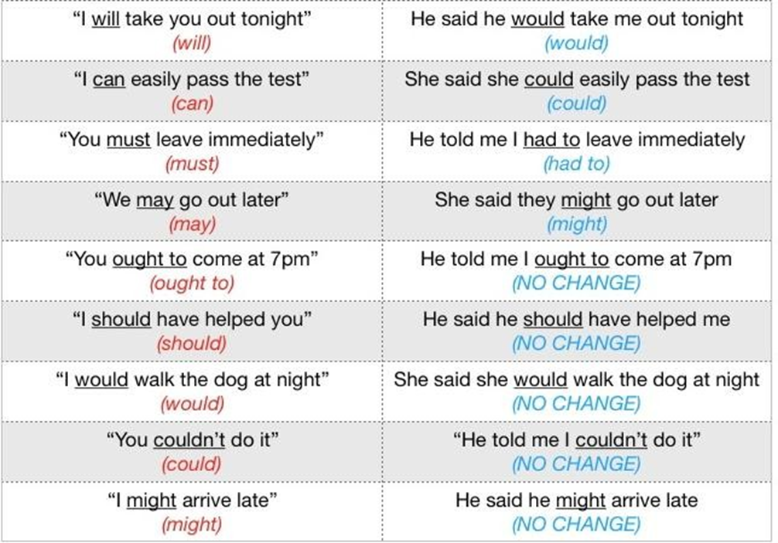

Slide 13
Rule #3 - Direct Speech to Indirect Speech Conversion - Interrogative Sentences
1. No conjunction is used, if a sentence in direct speech begins with a question (what/where/when) as the "question-word" itself acts as a joining clause.
Example:
Direct: “Where do you live?” asked the boy.
Indirect: The boy enquired where I lived.
2. If a direct speech sentence begins with auxiliary verb/helping verb, the joining clause should be ‘if’ or ‘whether’.
Example:
Direct: She said, “will you come for the party?”
Indirect: She asked whether we would come for the party.
3. Reporting verbs such as ‘said/ said to’ changes to enquired, asked, or demanded.
Example:
Direct: He said to me, “what are you wearing?”
Indirect: He asked me what I was wearing.

Slide 14
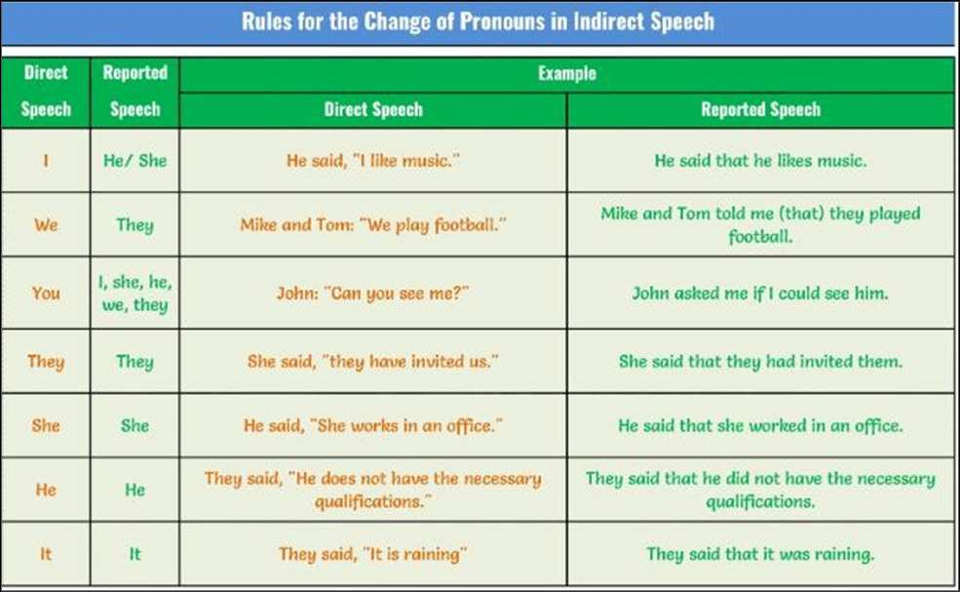
Rule #4 - Direct Speech to Indirect Speech Conversion - Pronouns

Slide 15
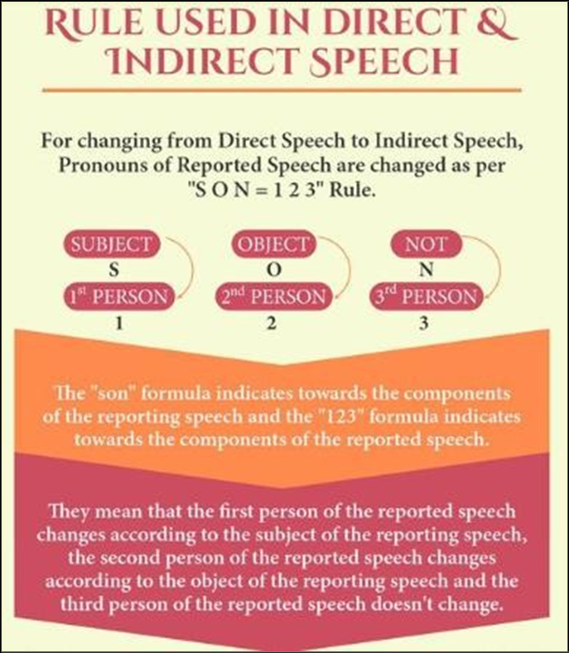

Slide 16
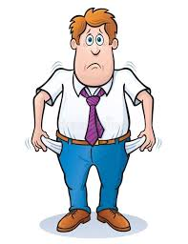
Rule #5 - Direct Speech to Indirect Speech Conversion - Request, Command, Wish, Exclamation
Indirect Speech is supported by some verbs like requested, ordered, suggested and advised. Forbid-forbade is used for the negative sentences. Therefore, the imperative mood in direct speech changes into the Infinitive in indirect speech.
Examples:
Direct: She said to her, “Please complete it.”
Indirect: She requested her to complete it.
Direct: Hamid said to John, “Sit down.”
Indirect: Hamid ordered John to sit down.
In Exclamatory sentences that express (grief, sorrow, happiness, applaud) Interjections are removed and the sentence is changed to an assertive sentence.
Example:
Direct: He said, “Alas! I am undone.”
Indirect: He exclaimed sadly that he was broke.

Slide 17

In direct speech the words actually spoken should be in (“ ”) quotes and always begin with a capital letter.
Example: She said, “I am the Best.”
Full stop, Comma, exclamation or question mark, are placed inside the closing inverted commas.
Example: They asked, “Can we sing with you?”
If direct speech comes after the information about who is speaking, comma is used to introduce the speech, placed before the first inverted comma.
Direct speech example: He shouted, “Shut up!”
Direct speech example: “Thinking back,” he said, “she didn't expect to win.” (Comma is used to separate the two direct speeches and no capital letter to begin the second sentence.)
Rule #6 - Direct Speech to Indirect Speech Conversion - Punctuations

Slide 18
Rule #7 - Direct Speech to Indirect Speech Conversion - Change of Time
In direct speeches, the words that express nearness in time or place are changed to words that express distance in indirect speech. Such as:
DIRECT SPEECH | INDIRECT SPEECH
Today | That day
Tonight | That night
Now | Then
Yesterday | The day before/ the previous day
Last night | The night before
Two days ago/ The day before yesterday | Earlier/ two days before
Tomorrow | The following day/ the next day
The day after tomorrow | In two days’ time
Next year/ week | The following year/ week
Last year/ week | The previous year/ week
An year ago | The previous year
Examples:
Direct: He said, “His girlfriend came yesterday.”
Indirect: He said that his girlfriend had come the day before.
NOTE: The time expression does not change if the reporting verb is in present tense or future tense.

Slide 19
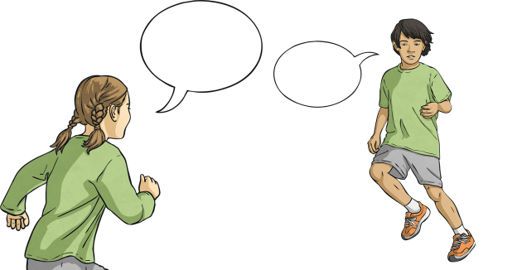
Rules while converting an Indirect Speech to Direct Speech
Use the reporting verb such as (say, said to) in its correct tense.
Put a comma before the statement and the first letter of the statement should be in capital letter.
Insert question mark, quotation marks, exclamation mark and full stop, based on the mood of the sentence.
Remove the conjunctions like (that, to, if or whether) wherever necessary.
Where the reporting verb is in past tense in indirect, change it to present tense in the direct speech.
Change the past perfect tense either into present perfect tense or past tense as necessary.

Slide 20

Examples:
Indirect: She asked whether she was coming to the prom night.
Direct: She said to her, “Are you coming to the prom night?”
2. Indirect: The girl said that she was happy with her result.
Direct: The girl said. “I am happy with my result.”

Slide 21
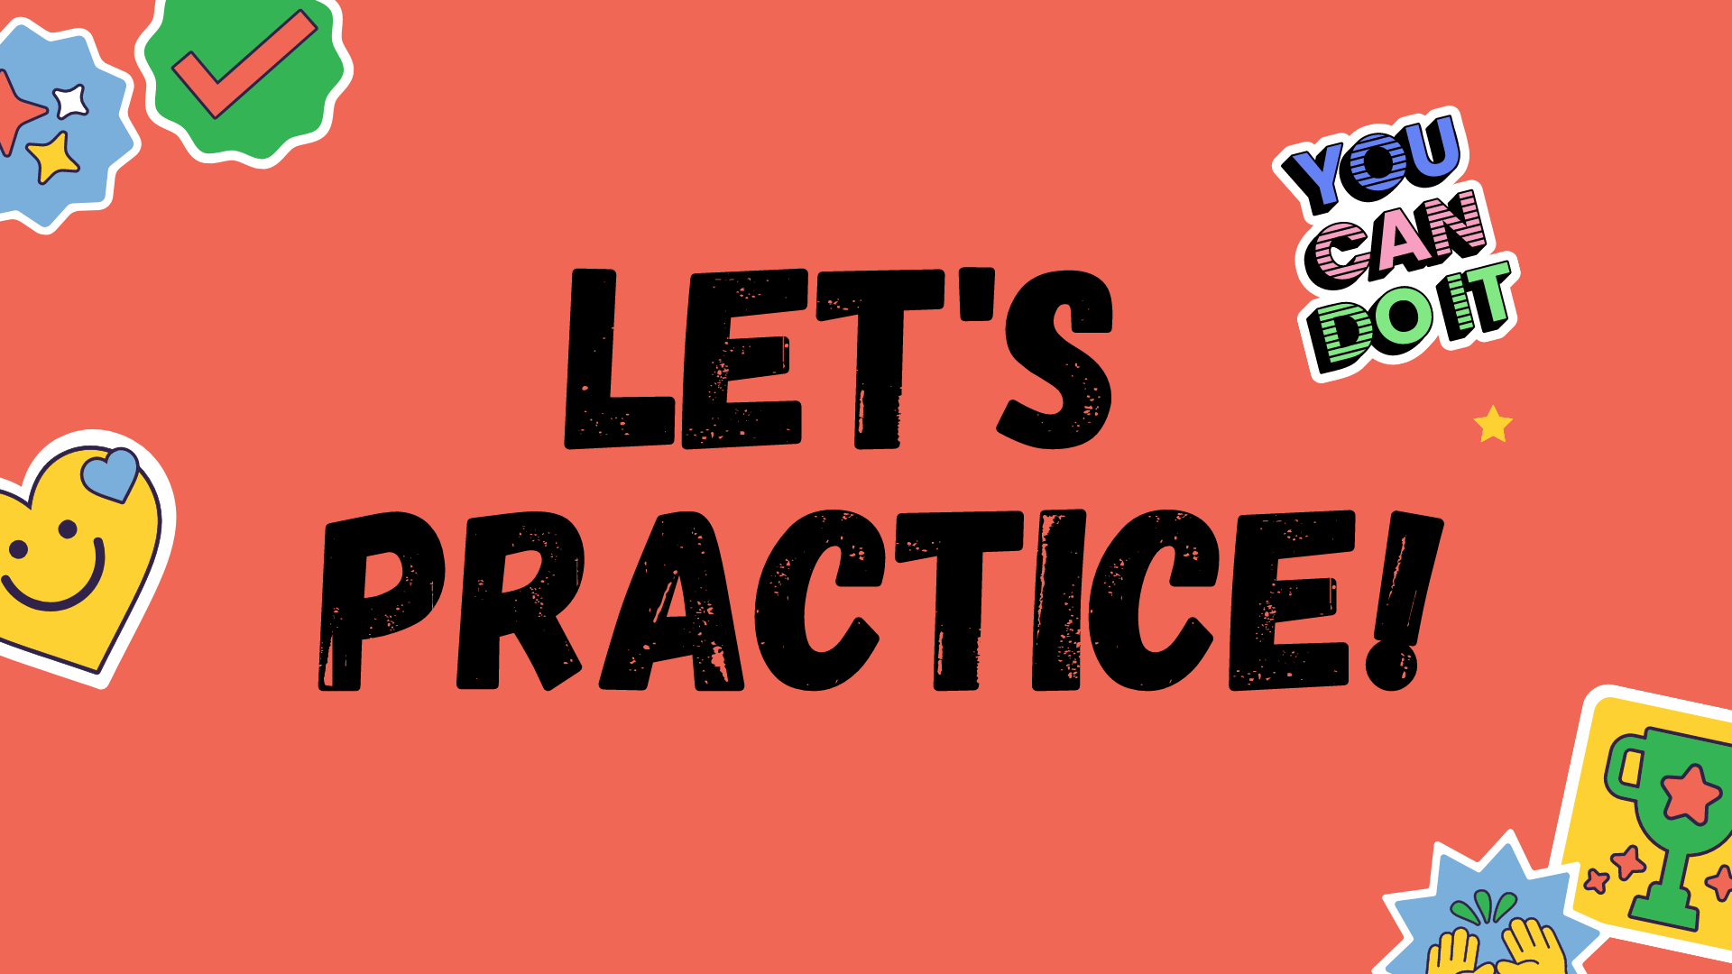

Slide 22

She said, “I am going to the store.”
She said that she is going to the store.
She said that she was going to the store.
She said that she will go to the store.
She said that she goes to the store.
2. John asked, “Have you finished your homework?”
John asked if I had finished my homework.
John asked if I have finished my homework.
John asked whether I had finished my homework.
John asked whether I have finished my homework.
3. They said, “We will meet you at the park.”
They said that they will meet me at the park.
They said that they would meet me at the park.
They said that they are meeting me at the park.
They said that they meet me at the park.

Slide 23

4. He said, “I am learning French.”
He said that he is learning French.
He said that he was learning French.
He said that he has been learning French.
He said that he had learned French.
5. The teacher said, “You must complete your assignments on time.”
The teacher said that I must complete my assignments on time.
The teacher said that I had to complete my assignments on time.
The teacher said that I must have completed my assignments on time.
The teacher said that I will complete my assignments on time.
6. She said, “I cannot find my keys.”
She said that she could not find her keys.
She said that she cannot find her keys.
She said that she could not find my keys.
She said that she could not find her keys.

Slide 24

ANSWER KEY
B
A
B
B
B
A

Slide 25


